Slide 1
Soil Nutrition and Health
Ray Ward
Ward Laboratories, Inc
Kearney, NE
www.wardlab.com
“Guiding producers today to feed the world tomorrow”

Slide 2
Saline County Corn
Year Corn Yield, bu/A
1879 40
1889 47
1929 33
1955 9
1956 8
www.wardlab.com

Slide 3
Soil Erosion

Slide 4
Poor Soil Structure Prevents Water Movement
Water
Saturated Soil
Air Space
Moisture Soil
Dry Soil

Slide 5
Soil Health basics
Armor the ground
Minimal soil disturbance
Crop diversity
Living root in the soil all the time
“Livestock”

Slide 6
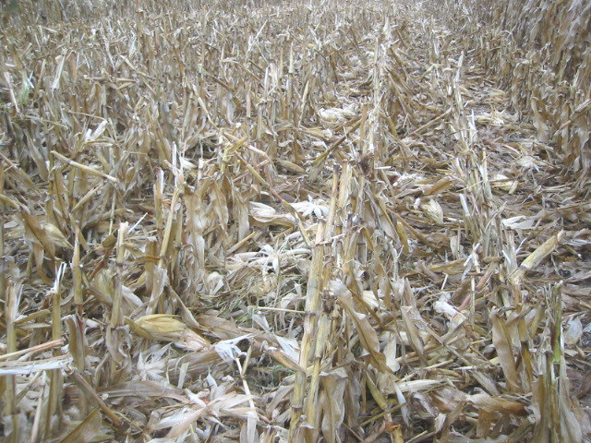
# 1 Armor the Soil

Slide 7
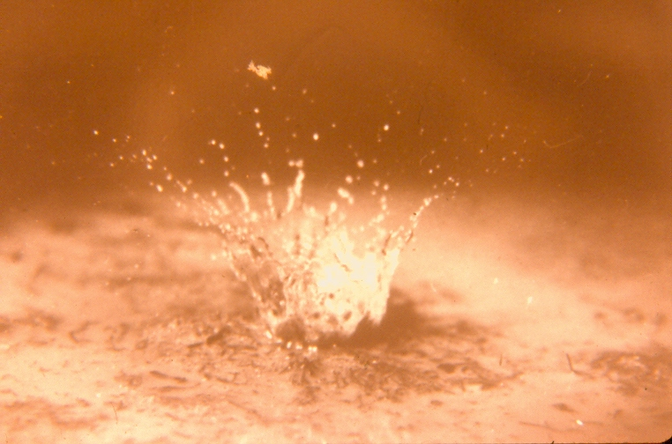
Protect the soil from raindrop splash

Slide 8
To Avoid Soil Crusting

Slide 9
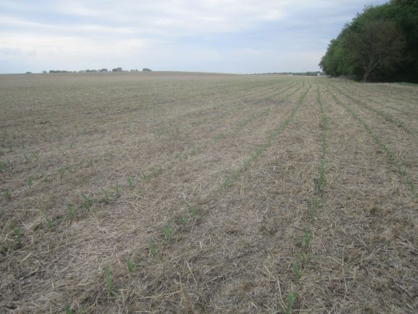
# 2 Minimal Soil Disturbance

Slide 10
# 3 Crop Rotation of 3 or more Crops

Slide 11
# 4 Living root in soil at all times

Slide 12
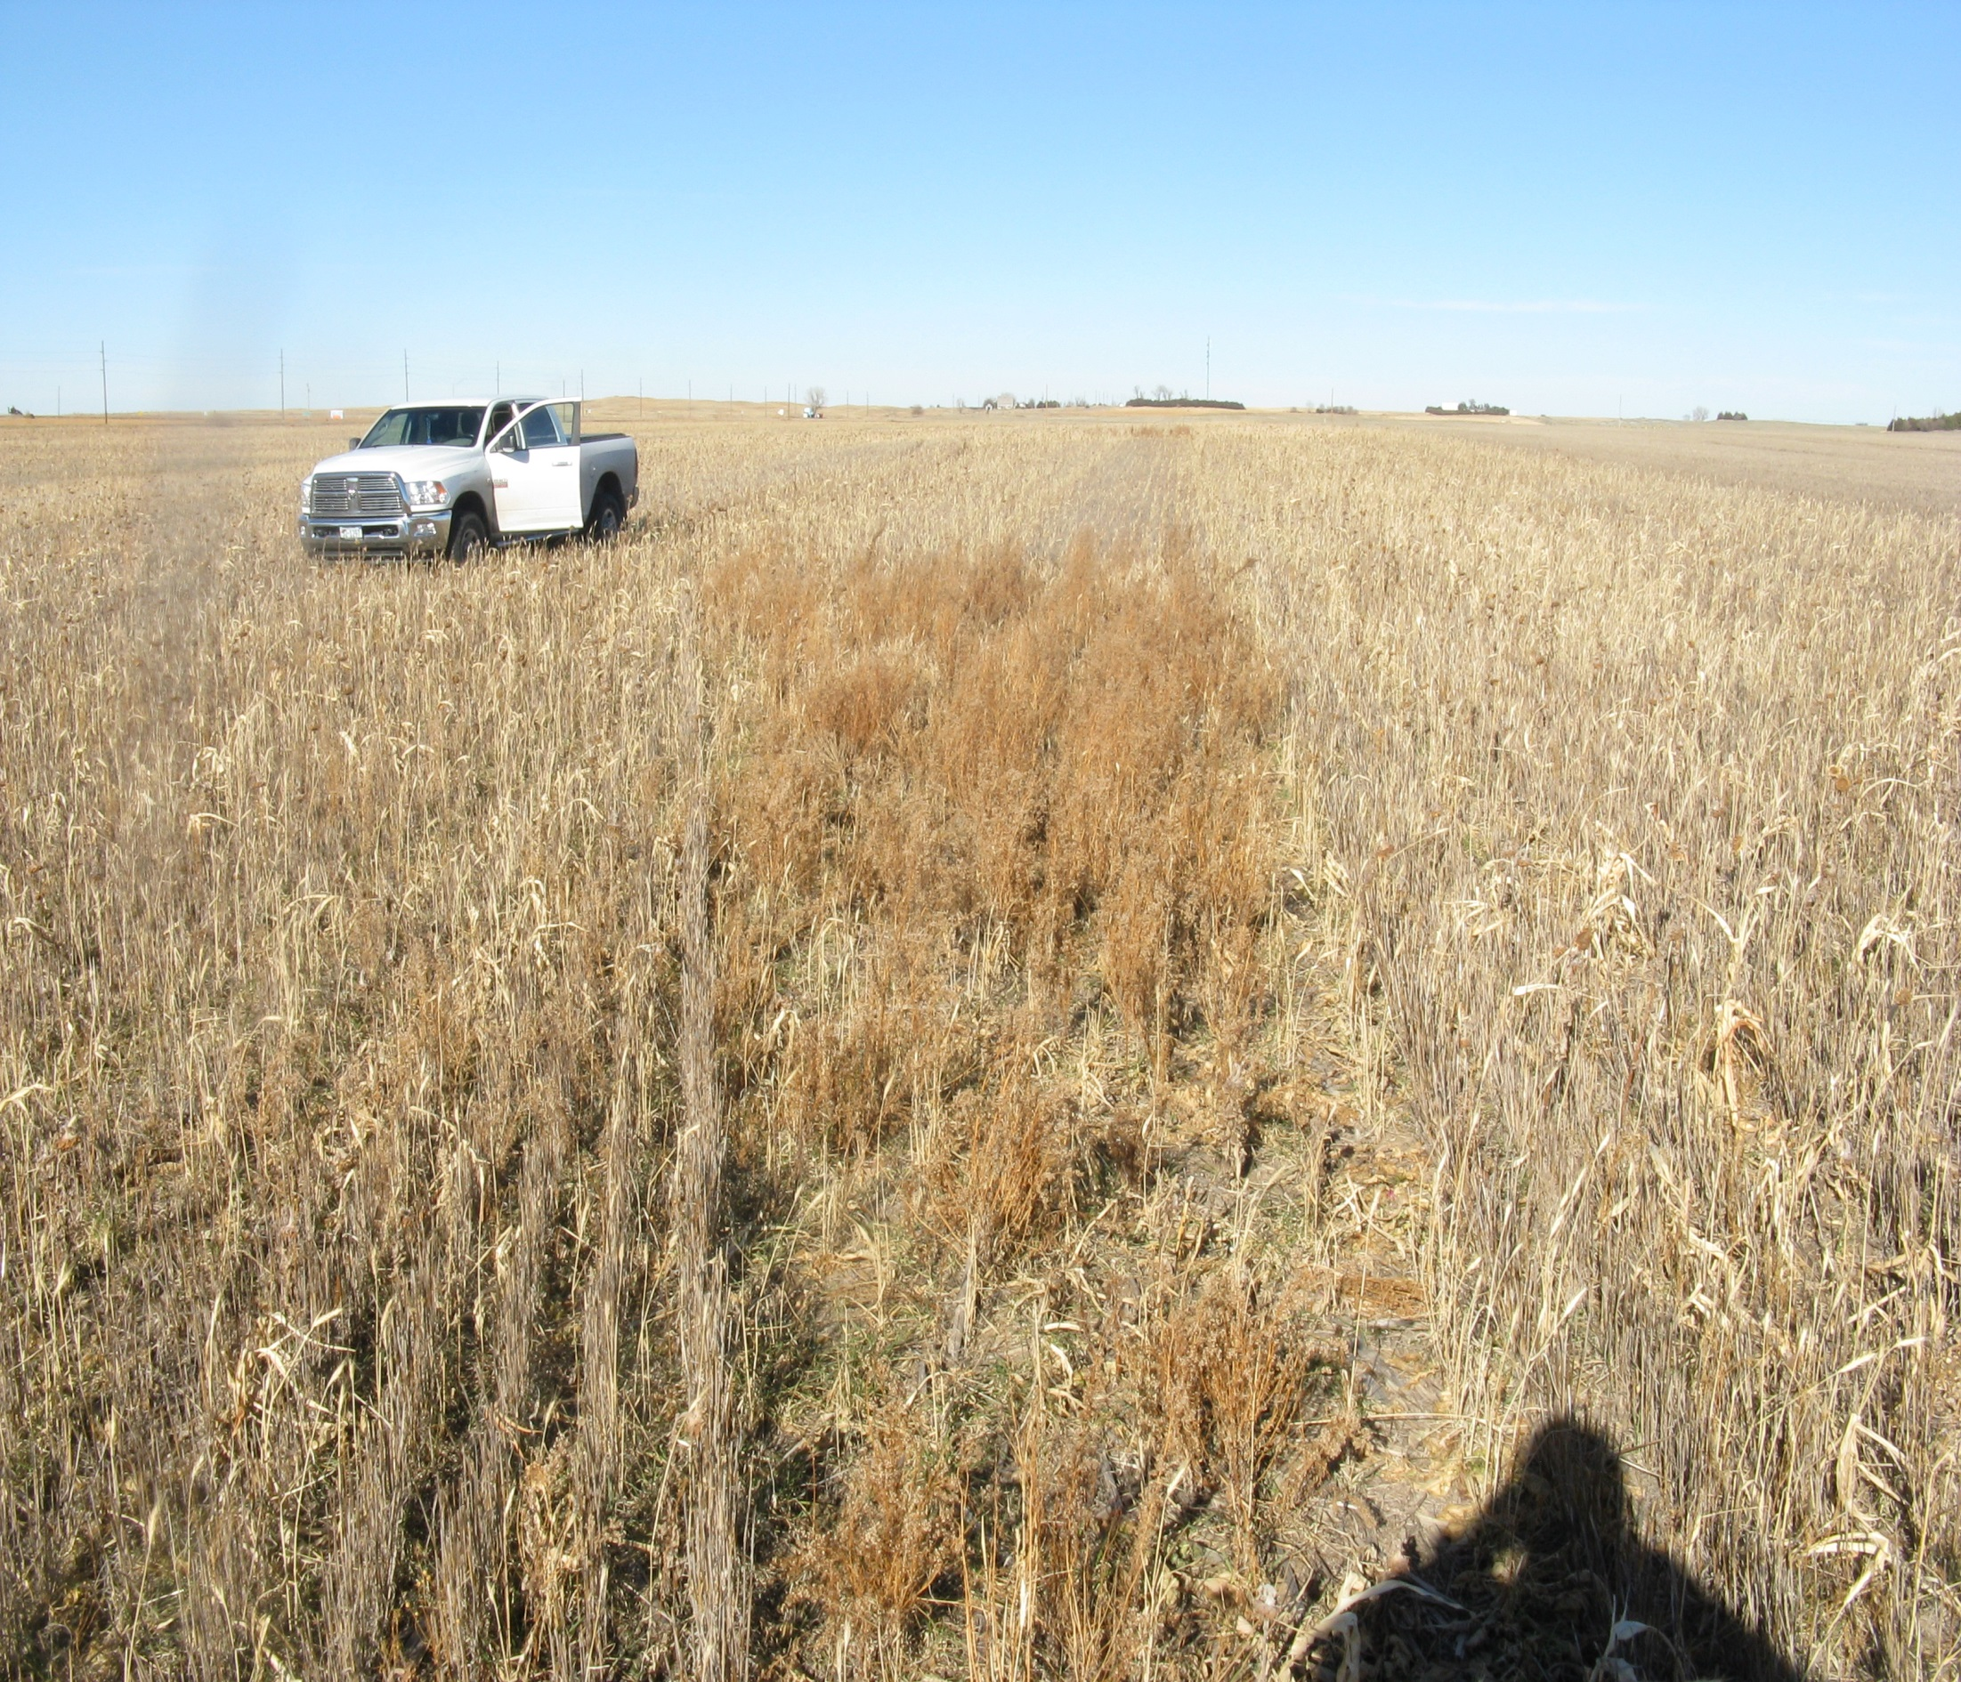
Mother Nature likes cover crops too

Slide 13
# 5 Livestock

Slide 14
#5 Variety of Livestock

Slide 15
Factors Affecting Active Nutrient Uptake
Oxygen
Temperature
Ion Interference

Slide 18
Soil Organic Matter
Enhance crop productivity
Build soil fertility
Improve structure
Build aggregate stability
Increase nutrient retention
Increase water holding capacity

Slide 19
Soil Organic Matter
Range 1 to 5 % +
One percent OM contains
1000 lbs of N
220 lbs of P2O5
140 lbs of S
All other nutrients

Slide 20
Nitrogen Requirement
Corn 1.1 lbs N/Bu
Wheat 2.4 lbs N/Bu
Milo 1.1 lbs N/Bu
Grass mix 35 lbs N/Ton
Sunflower 50 lbs N/1000 lbs

Slide 21
Residual Nitrate
Carryover nitrate
It is available to the next crop
Nitrate is soluble. It will move with water moving through the soil.

Slide 22
Nitrogen Requirement
Corn 1.1 lbs N/Bu
This is the amount of N in the plant and in the grain. The plant needs this much to grow the desired yield. It is not the amount of N fertilizer to apply.

Slide 23
Nitrogen Recommendation for Corn
Recommendation, lbs N/A = (yield * N req.)
Minus lbs of NO₃-N in 24 or 36” of soil
Minus Legume credit
Minus Manure credit
And minus Irrigation water credit

Slide 24
Soil Phosphorus Mehlich 3 or Bray P1
Phosphorus: 25 ppm P
Above 50 ppm P
No phosphate fertilizer is needed

Slide 25
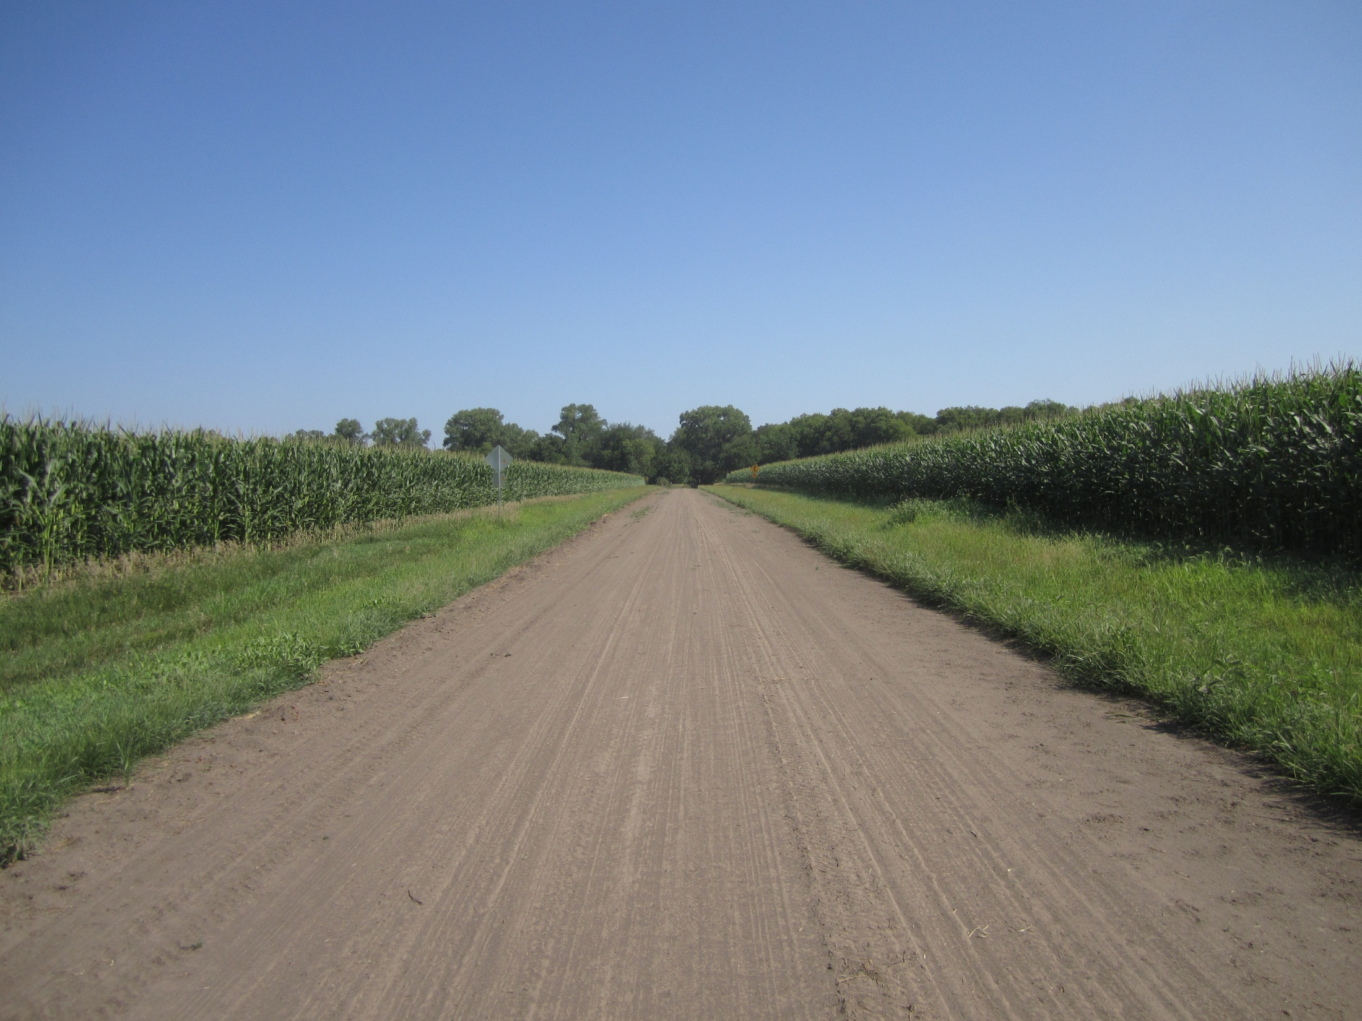
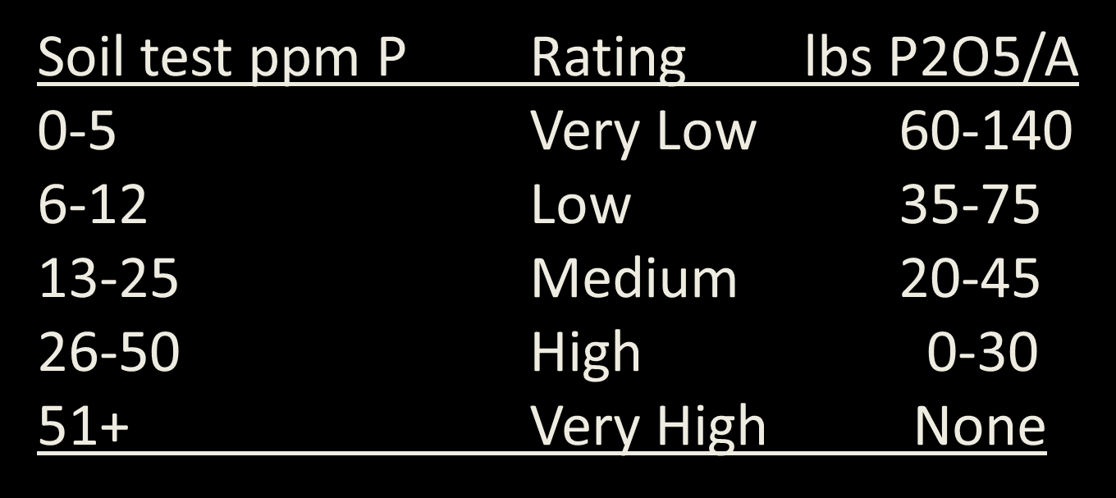
Phosphorus Recommendations for Corn

Slide 26
Exchangeable Soil Potassium
Potassium soil test: 160 ppm K
Above 200 ppm K: No Potash fertilizer is needed

Slide 27
Potassium Recommendations for Corn
Soil Test ppm K Rating lbs K2O
0-40 Very Low 90-200
41-80 Low 50-120
81-120 Medium 25-60
121-200 High 0-35
201+ Very High None

Slide 28
Sulfur Requirement
Crop Yield Unit LBS of S
Corn Bushel 0.22
Soybean Bushel 0.25
Wheat Bushel 0.32
Alfalfa Ton 5.0
Grass Ton 3.0

Slide 29
Sulfur Recommendation Example
Corn at 240 bu/A Yield Goal
Sulfur Requirement is 0.22 lb S/bu
Total S Required is 53 lbs/A
Sulfate Soil Test is 14 ppm S
14 ppm X 0.3 X 8 inches = 34 lbs S/A
S fertilizer = 19 lbs of S/A
Recommendation is 28 lbs S/A

Slide 30
Calcium, Magnesium, and Sodium
Part of the base saturation. % K, %Ca, %Mg, and % Na should add up to 70 % or greater
Hydrogen. H should be less than 30 %.
If sodium (Na) percentage is greater than 5%, a soil aggregation becomes a problem.

Slide 31
Zinc, DTPA Extraction
Trace element that is needed on the most acres of crop land.
The zinc test needs to be greater than 1 ppm Zn.

Slide 32
Zinc Recommendations
DPTA, ppm Zn lb Zn/A
0-0.25 3-12
0.26-0.50 1-7
0.51-.75 0-6
0.76-1.00 0-3
1.01+ None
Divide Rate by 6 for amount per year.

Slide 33
Manganese, DTPA Extraction
Manganese seems to be getting lower in our soils.
Manganese may be needed when soil test is below 2.0 ppm Mn
Possible soil treatment of 10 lbs of manganese sulfate per acre.

Slide 34
Soil Boron
For most crops, Hot Water Soluble Boron soil test should be above 0.25 ppm B
For alfalfa, sugar beets and peanuts boron should be above 0.50 ppm B

Slide 35
Boron Soil Test and Recommendations
B Soil Test, ppm Rating Lbs B/A
0 – 0.25 Low 0.5 – 3.0
0.26 – 0.50 Medium 0.0 – 1.7
0.51 + High 0
Alfalfa, clover, peanuts, cotton and sugar beets require more boron than other crops.

Slide 36
Nutrient Crop Removal, lbs/Bu
CORN
Nutrient lb/bu 240 bu/A
Nitrogen, N 0.67 161
Phosphorus, P2O5 0.35 84
Potassium, K2O 0.25 60
Sulfur, S 0.08 22
Zinc, Zn 0.001 0.24

Slide 37
Nutrient Crop Removal, lbs/Bu
CORN
Nutrient lb/bu 240 bu/A
Chloride 0.024 5.8
Manganese 0.0006 0.14
Iron 0.0012 0.29
Copper 0.0004 0.10
Boron 0.0006 0.14
Molybdenum 0.00001 0.002

Slide 38
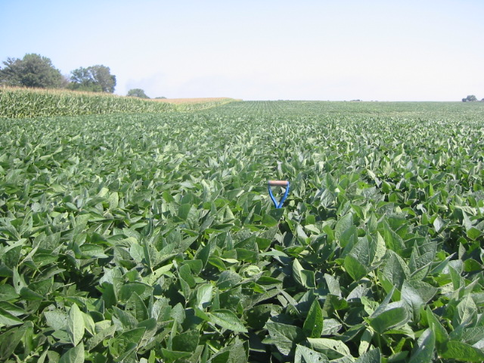
Crop Nutrient Mining, lbs/bu
SOYBEAN
Nutrient lb/bu 45 bu/A
Nitrogen, N 3.4 153
Phosphorus, P2O5 0.77 35
Potassium, K2O 1.2 54
Sulfur, S 0.18 8
Zinc, Zn 0.003 0.09

Slide 39
Plants would prefer to grow new leaves by producing carbohydrates with old leaves than by moving stored carbohydrates from roots.

Slide 40
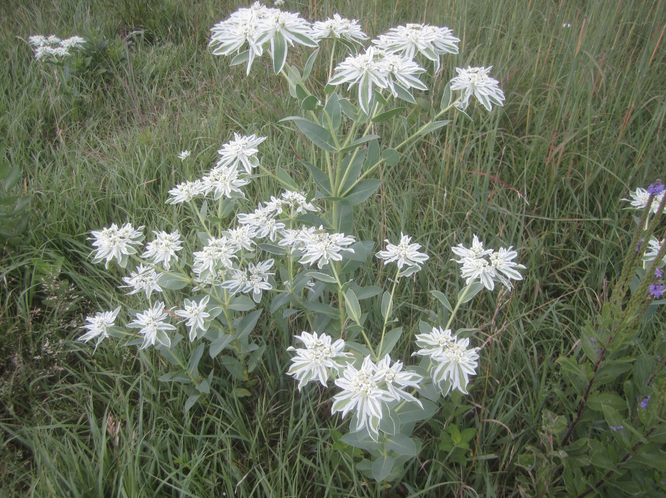
Soil pH
Strongly acid 4.0 – 5.4
Moderately acid 5.5 – 6.1
Neutral pH 6.2 – 7.2
Alkaline 7.3 – 7.8
Strongly alkaline 7.9 – 8.4

Slide 41
Buffer pH
Measures total acidity
Buffer pH measures the amount of H ions (acidity) held on cation exchange.
Lime recommendation
(7.0 – Buffer pH) times 4 = Tons of Effective Calcium Carbonate (ECC) per acre.
Tons of ECC divided by % effectiveness = Tons of ag lime per acre.

Slide 42
EC (soluble salts) mS/cm
Soluble Salts (EC), mS/cm (mmho/cm)
0.15 - 0.75 No crop hazard
0.75-1.5 Yield reduction on sensitive crops
1.5-3.0 Moderate yield reduction
3.1+ Severe yield reduction

Slide 43
Grass Health
1) Each year 30 percent of each grass plant’s root system must be replaced plus try to expand the existing root system.
2) Constant removal of vegetative growth from the surface greatly impairs the ability of the plant to replace the root system loss, let alone expand the root system.
3) Continual removal without rest, significantly damages the health of the root system. Overgrazing allows weed growth to occur and endangers the pastures ability to be a “sustainable” resource.

Slide 46
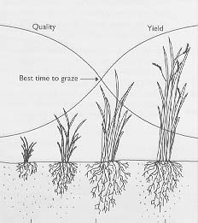
Forage Growth Curve
Quality
Yield
Best time to graze
Stage of maturity greatly influences forage quality and availability of nutrients.
Notes:
Freshly grazed
photo synthesis low
depletion of energy reserves
slow growth
Lush vegetative growth
photosynthesis high
renewal of energy reserves
rapid growth
Flowering and seeding
photosynthesis reduced due to shading
energy diverted to flower and seed production
slow growth

Slide 47
Grass Health
1) Plant roots stay strong and healthy when grazing periods are short and rest or recovery periods are long.
2) When grazing periods are long and rest/recovery periods are short, root systems begin to suffer.
When grazing periods are continuous and rest/recovery periods are nonexistent, root and plant vigor decreases.

Slide 49
Grazing management affects roots

Slide 50
Water supply

Slide 51
Soil Health
CO2-C 24 hr. burst test (Respiration)
Estimate of Microbial Biomass and Activity

Slide 52
CO2-C 24 hr. Respiration test
24 hr CO2-C Burst uses drying and rewetting techniques to mimic natural field events and measures the flush of microbial respiration from microbial biomass leading to nutrient cycling.
The amount of activity is related to soil habitat including available food and soil fertility.
http://solvita.com/soil

Slide 53
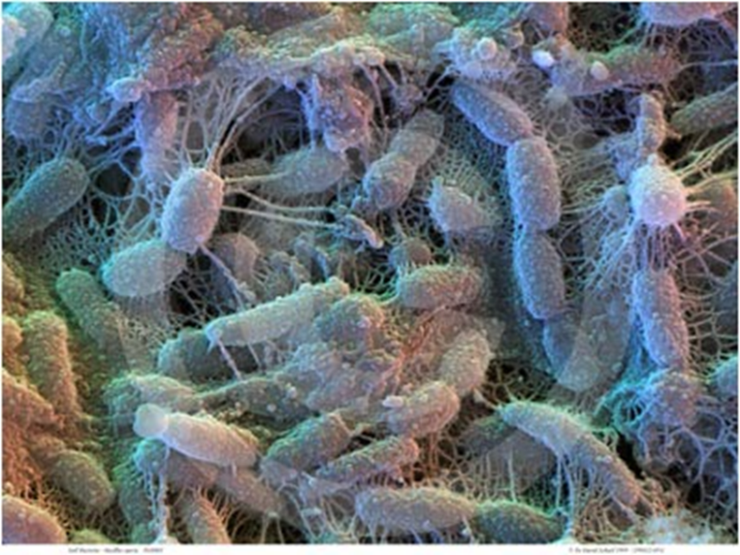
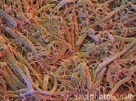
Microbial Activity - Soil bacteria and fungi 1,000,000-10,000,000 per gram of soil

Slide 55
CO2-C 24 hr. Respiration test
Good number = 60 ppm CO2-C
How high?
120 ppm CO2-C?
200 PPM CO2-C?
http://solvita.com/soil

Slide 56
Water Extract
Food that is in the water film is available for microbe growth and function

Slide 57
Water Extract
Total Organic Carbon (WEOC)
Water soluble Carbon is the food for microbes.
Good number is 150 to 250 ppm C depending on CO2-C burst test.

Slide 58
Water Extract
Total Nitrogen
Organic Nitrogen (WEON)
What is left after subtracting nitrate and ammonium.
WEON 40 to 60 % of total N is excellent
This organic N and Ammonium are missed in regular soil testing

Slide 59
MAC Calculation
Microbial Active Carbon (% MAC)
(Respiration 24 hr CO2-C / WEOC) * 100
WEOC = water extractable organic carbon
For example: (77.0 / 182) * 100 = 42.3
A good reading is above 20 % and below 80 %

Slide 60
Soil Health Calculation
CO2-C respiration
C:N ratio
WEOC
WEON
Soil Health = (CO2-C/10) + WEOC/50 + WEON/10
Good score greater than 7

