Slide 1
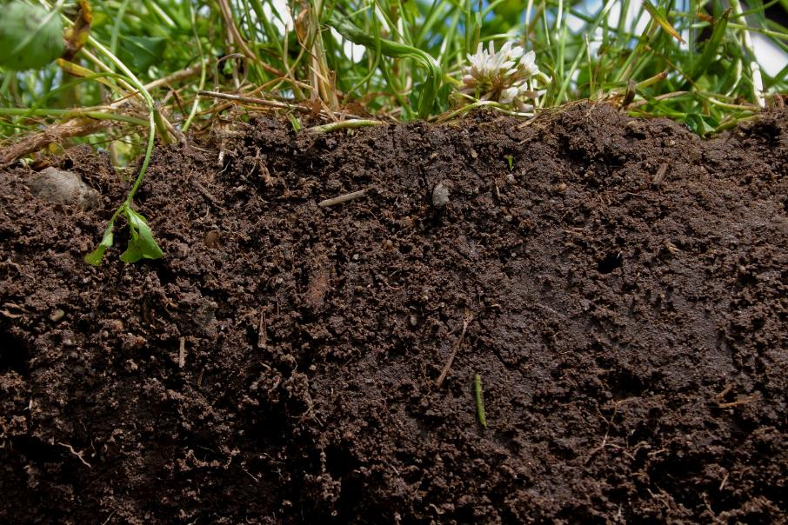
Soil Fertility Impacting Soil Health
Ray Ward
Ward Laboratories Inc.
Kearney, NE
www.wardlab.com
“Guiding Producers Today to Feed the World Tomorrow”
http://www.betterground.org/soil-quality-2/

Slide 2
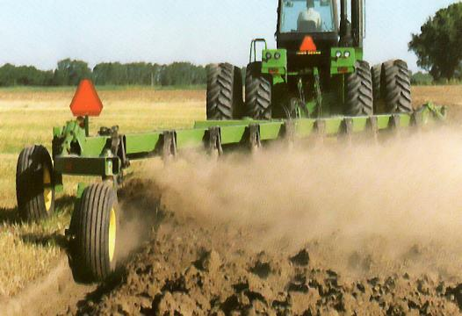
No. 1 Environmental Enemy in Production Agriculture
Intensive Tillage

Slide 3
Saline County Dryland Corn
Year Corn Yield, bu/A Acres Planted
1879 40 57,480
1889 48 134,850
1929 33 87,438
1955 9 88,410
1956 8 76,340
www.wardlab.com

Slide 4
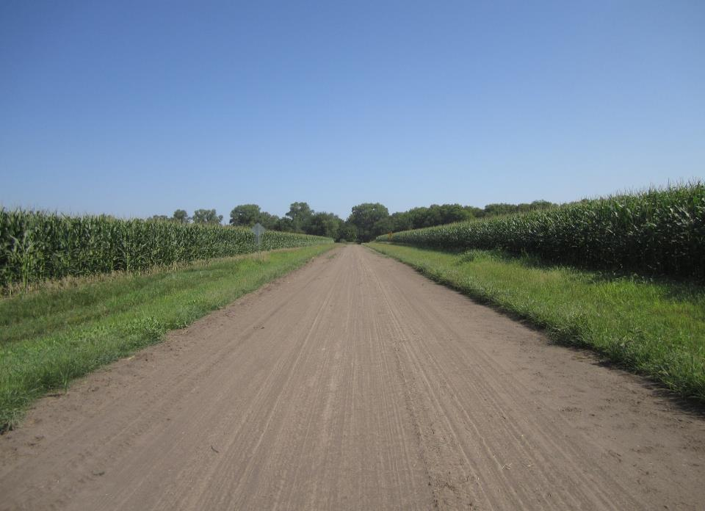
Nutrient Crop Removal, lbs/Bu
CORN
Nutrient lb/bu 240 bu/A
Nitrogen, N 0.67 161
Phosphorus, P2O5 0.35 84
Potassium, K2O 0.25 60
Sulfur, S 0.08 22
Zinc, Zn 0.001 0.24

Slide 5
Nutrient Crop Removal, lbs/Bu
CORN
Nutrient lb/bu 240 bu/A
Chloride 0.024 5.8
Manganese 0.0006 0.14
Iron 0.0012 0.29
Copper 0.0004 0.10
Boron 0.0006 0.14
Molybdenum 0.00001 0.002

Slide 6
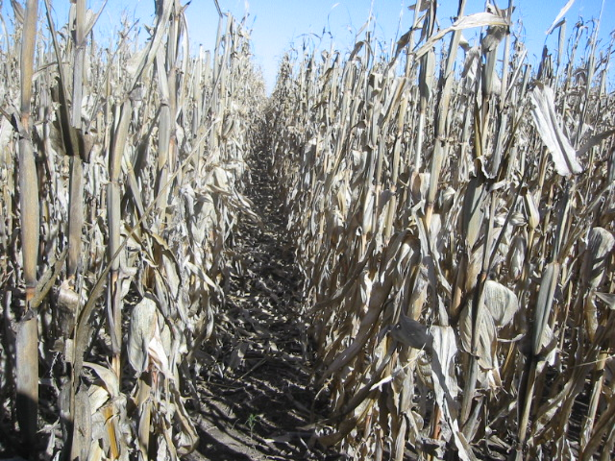
Nutrient Content of Corn Residue
Nutrient lbs per ton
Nitrogen, N 18
Phosphorus, P2O5 4
Potassium, K2O 30
Sulfur, S 3

Slide 7
Water Erosion

Slide 8
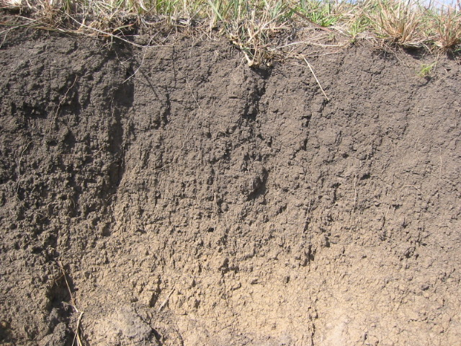
Native Soil Structure
Native Soil Root Zone

Slide 9
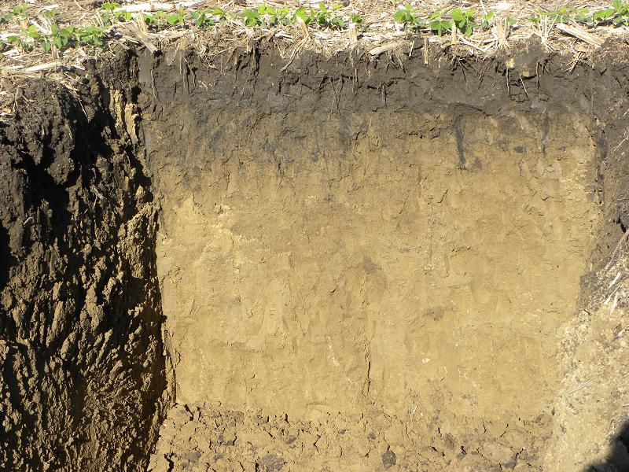
Cultivated Soil Root Zone

Slide 10
Soil Structure

Slide 11
Soil Structure
Retention & transport of water & nutrients
Habitat for Microbes
Reduced Soil Erosion

Slide 12
Crusted Soil
Crust Bulk density = 1.74 g/cc

Slide 13
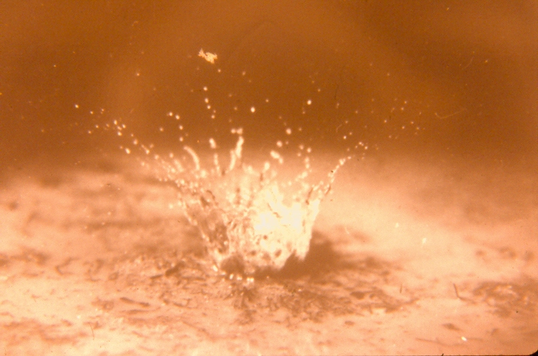
Raindrop Splash

Slide 14
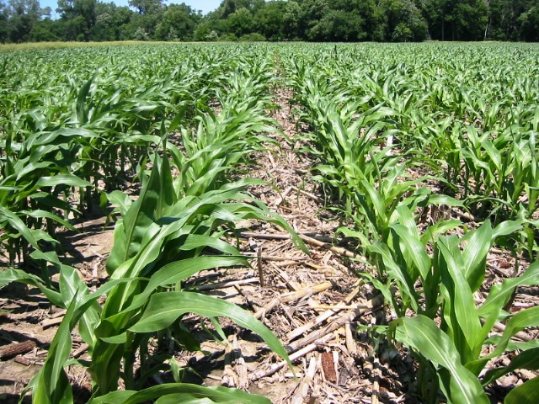
Ground Cover

Slide 15
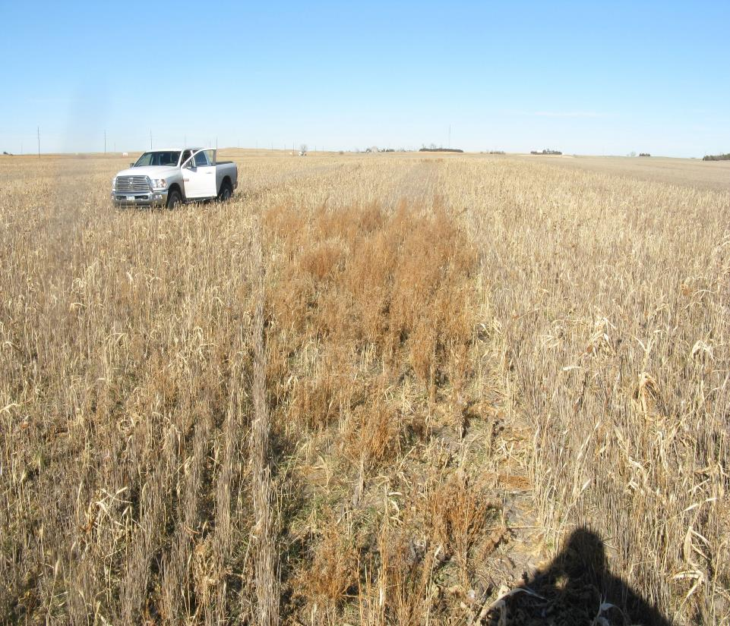

Slide 16
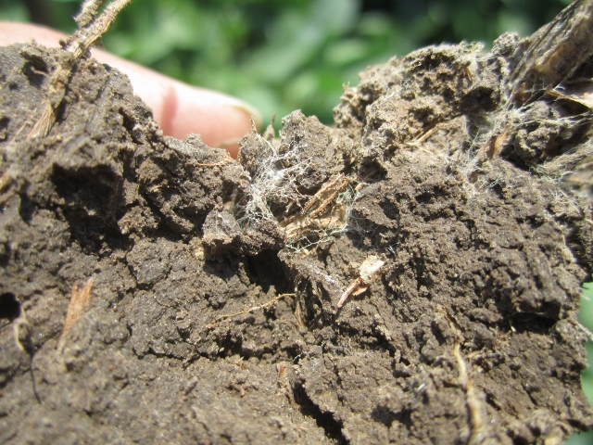

Slide 17
Soil Health
I was introduced to no-till planting in the mid-70’s
Kentucky was no-tilling corn into fescue grass
I was watching Dwayne Beck do no-till work in South Dakota
September 1992: I finally convinced myself that no-till was the way to go
www.wardlab.com

Slide 18
Soil Health – It is a progression
Residue on the ground made me realize that this protected the soil from raindrop splash
Soil protection and water savings was the start
Then I noticed more worm activity
Then decided that cover crop should be added to the wheat stubble as part of the rotation
www.wardlab.com

Slide 19
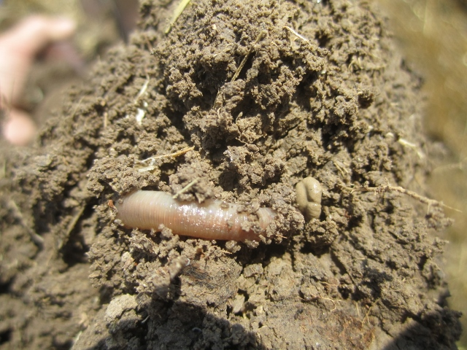

Slide 20
Soil Health
Part of soil health is keeping everything feed
If we mine nutrients out of the soil and do not replace them soil health decline

Slide 21
Soil pH
Neutral pH 6.2 – 7.2
Very Acid less than 5.1
Moderately acid 5.1 – 5.6
Alkaline 7.3 – 7.8
Very alkaline 7.9 – 8.4

Slide 22
Buffer pH
Measures total acidity
Buffer pH measures the amount of H ions (acidity) held on cation exchange
Lime recommendation
(7.0 – Buffer pH) times 4 = Tons of ECC per acre
Tons of ECC divided by effectiveness = Tons of ag lime per acre

Slide 23
EC (soluble salts) mS/cm
Soluble Salts (EC), mS/cm (mmho/cm)
0.1-0.75 No crop hazard
EC can be an indicator of soil life
0.75-1.5 Yield reduction on sensitive crops
1.5-3.0 Moderate yield reduction
3.1+ Severe yield reduction

Slide 24
Organic Matter
Range 1 to 5+ %
One percent OM contains
1000 lbs of N
220 lbs of P2O5
140 lbs of S
All other nutrients

Slide 25
Residual Nitrate
Carryover nitrate
It is available to the next crop
Nitrate is soluble. It will move with water moving through the soil.

Slide 26
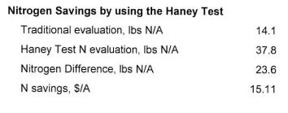
N Management
Tradition evaluation = NO3
Haney Evaluation = NO3 + NH4 + Organic N Release

Slide 27
Nitrogen Requirement
Corn 1.1 lbs N/Bu
Wheat 2.4 lbs N/Bu
Milo 1.1 lbs N/Bu
Grass mix 35 lbs N/Ton
Sunflower 50 lbs N/1000 lbs

Slide 28
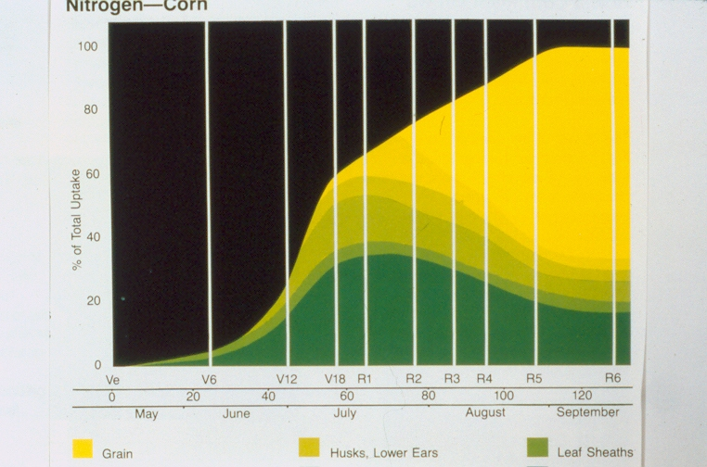
Nitrogen - Corn

Slide 29
Phosphorus
Phosphorus is attached to soil particles and does not move very far in the soil from year to year.
Yes, phosphorus does move in the soil. About 0.75 of an inch per year for silt loam soils and about 2 inches in sandy soils.
Phosphorus is not fixed but remains available for future use by plants.

Slide 30
Phosphorus Soil Test Ratings
Soil test ppm P
Mehlich3/Bray P-1 Olsen Rating
0-5 0-3 Very Low
6-12 4-7 Low
13-25 8-15 Medium
26-50 16-30 High
51+ 31+ Very High

Slide 32
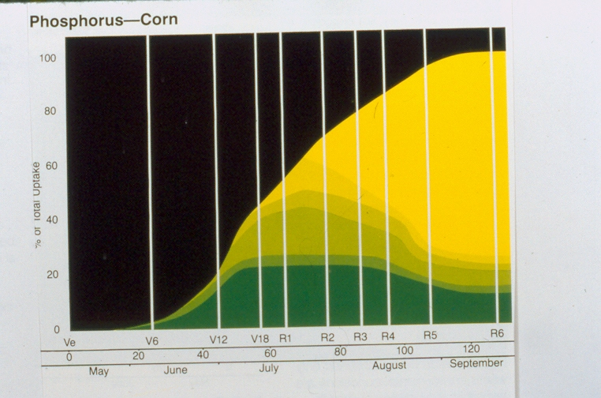
Phosphorus Corn

Slide 33
Potassium Recommendations
Soil Test ppm K Rating lbs K2O/A
0-40 Very Low 90-200
41-80 Low 50-120
81-120 Medium 25-60
121 - 200 High 0-35
201+ Very High None

Slide 34
Potassium

Slide 35
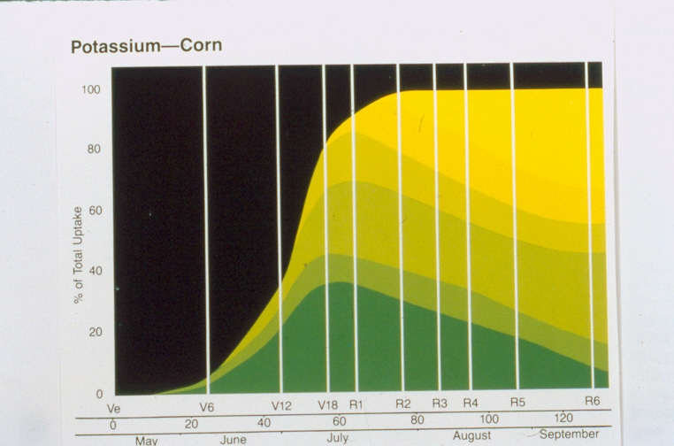
Potassium Corn

Slide 36
Sulfur Soil Test, Ca-P Extractable
Soil Test ppm S Rating
0-4 Very Low
5-9 Low
10-15 Medium
16-21 High
22+ Very High

Slide 37
Calcium, Magnesium, and Sodium
Part of the base saturation should add up to 70 % or greater
Hydrogen. H should be less than 30 %.
If sodium (Na) percentage is greater than 5% there is a problem.

Slide 38
Calcium:Magnesium Ratio
In summary, the Ca:Mg ratio concept is unproven and should not be used as a basis for fertilization or liming practices.
Having sufficient levels of Ca and Mg is the proper method of evaluation.
rather than trying to manipulate ratios.

Slide 39
Zinc Recommendations
DPTA, ppm Zn lb Zn/A
0-0.25 3-12
0.26-0.50 1-7
0.51-.75 0-6
0.76-1.00 0-3
1.01+ None
Divide Rate by 6 for amount per year.

Slide 41
Manganese Soil Test (DTPA) and Recommendations
Mn Rate
DTPA, ppm Mn Rating Lbs Mn/A
0-0.5 V Low 11
0.6-1.5 Low 6-10
1.6 – 3.0 Medium 1-5
3.1+ High 0

Slide 42
Copper Soil Test (DTPA) and Recommendations
DTPA, ppm Cu Rating Lbs of Cu/A
0-0.10 Very Low 3-6
0.11-0.20 Low 1-2
0.21-0.30 Medium 0
0.31-0.60 High* 0
0.61+ Very High 0
* Specialty crops get Copper up to 0.60 ppm

Slide 43
Boron Soil Test and Recommendations
B Soil Test, ppm Rating Lbs B/A
0 – 0.25 Low 0.5 – 3.0
0.26 – 0.50 Medium 0.0 – 1.7
0.51 + High 0
Alfalfa, clover, peanuts, cotton and sugar beets require more boron than other crops.

Slide 44
Soil Chloride, 24 inch Sample
Rating ppm Cl lbs Cl/A
Low 0-3 20
Medium 4-6 10
High 6+ 0
From KSU

Slide 45
Factors Affecting Active Nutrient Uptake
Oxygen
Temperature
Ion Interference

Slide 46
Soil Health – It is a progression
Now I see improvements in our soils
Haney test is an indicator of soil biological activity
If soil biological activity increases in my soil can I reduce my fertilizer and pesticide inputs?
Is this the system of the future?
www.wardlab.com

