Slide 1
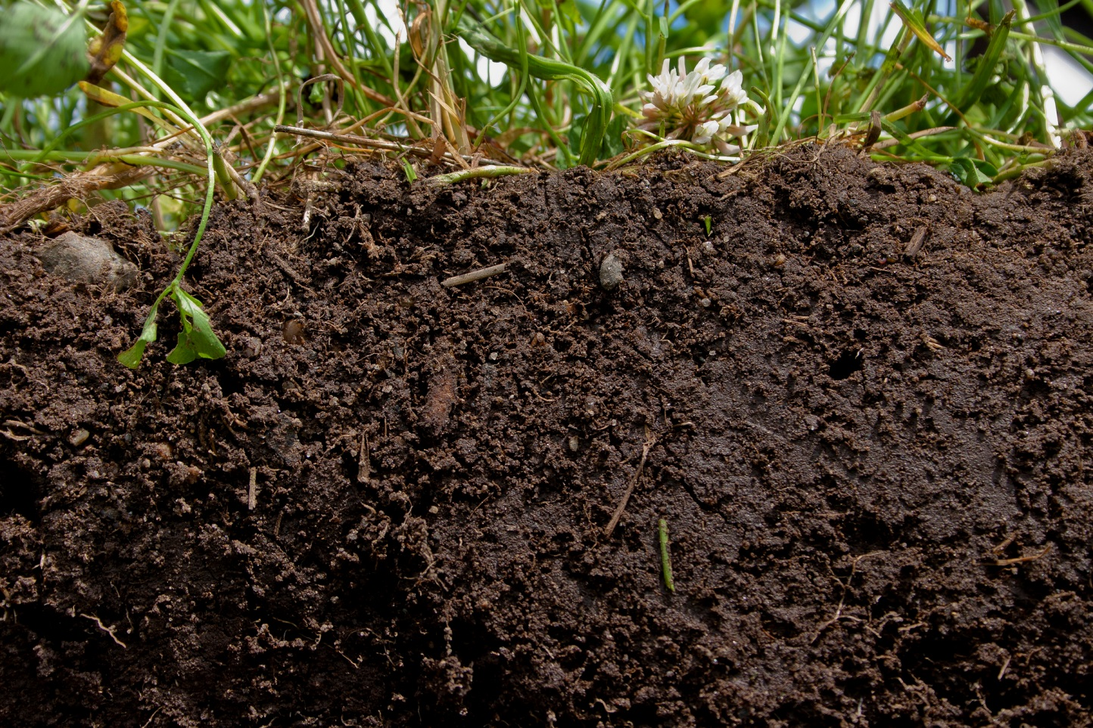
Understanding Soil Test Results and Fertilizer Recommendations
Ray Ward
Ward Laboratories Inc.
Kearney, NE
www.wardlab.com
“Guiding Producers Today to Feed the World Tomorrow”
http://www.betterground.org/soil-quality-2/

Slide 2
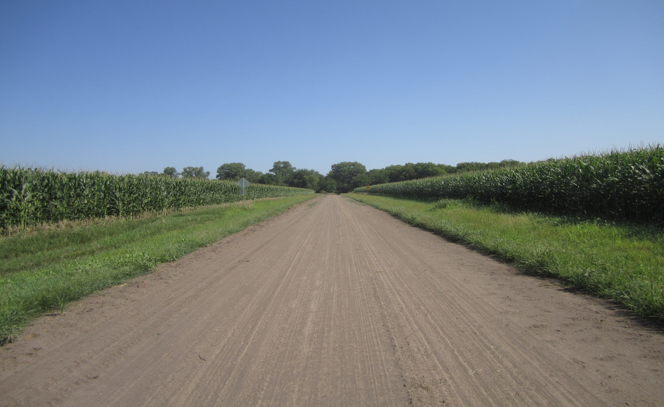
Nutrient Crop Removal, lbs/Bu
CORN
Nutrient lb/bu 240 bu/A
Nitrogen, N 0.67 161
Phosphorus, P2O5 0.35 84
Potassium, K2O 0.25 60
Sulfur, S 0.08 22
Zinc, Zn 0.001 0.24

Slide 3
Nutrient Crop Removal, lbs/Bu
CORN
Nutrient lb/bu 240 bu/A
Chloride 0.024 5.8
Manganese 0.0006 0.14
Iron 0.0012 0.29
Copper 0.0004 0.10
Boron 0.0006 0.14
Molybdenum 0.00001 0.002

Slide 4
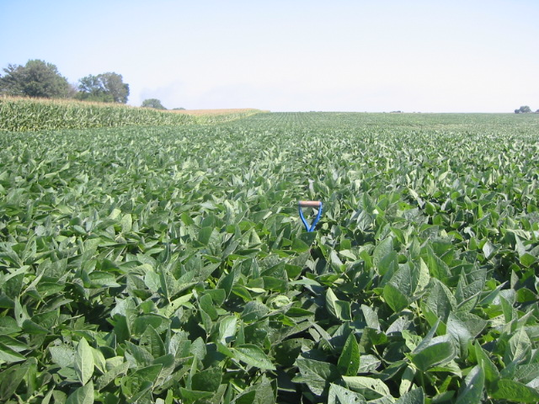
Crop Nutrient Removal, lbs/bu
SOYBEAN
Nutrient lb/bu 60 bu/A
Nitrogen, N 3.3 198
Phosphorus, P2O 0.73 44
Potassium, K2O 1.2 72
Sulfur, S 0.18 11
Zinc, Zn 0.003 0.18

Slide 5
Crop Nutrient Removal, lbs/bu
SOYBEAN
Nutrient lb/bu 60 bu/A
Chloride 0.016 1.0
Iron 0.005 0.3
Manganese 0.002 0.12
Copper 0.001 0.06
Boron 0.0006 0.04
Molybdenum 0.00001 0 .0006

Slide 6
Soil pH
Neutral pH 6.2 – 7.2
Very Acid less than 5.1
Moderately acid 5.1 – 5.6
Slightly acid 5.7 – 6.1
Alkaline 7.3 – 7.8
Very alkaline 7.9 – 8.4

Slide 7
Buffer pH
Measures total acidity
Buffer pH measures the amount of H ions (acidity) held on cation exchange
Lime recommendation
(7.0 – Buffer pH) times 4 = Tons of ECC per acre
Tons of ECC divided by effectiveness = tons of ag lime per acre

Slide 8
EC (soluble salts) mS/cm
Soluble Salts (EC), mS/cm (mmho/cm)
0.1-0.75 No crop hazard
EC can be an indicator of soil life
0.75-1.5 Yield reduction on sensitive crops
1.5-3.0 Moderate yield reduction
3.1+ Severe yield reduction

Slide 9
What are soluble salts
Calcium and magnesium
Sulfate and nitrate
Other plant nutrients
Saline seeps
Alkali Spots

Slide 10
Organic Matter
Organic matter holds water and plant nutrients
Organic matter is 58 % carbon
Contains Plant Nutrients

Slide 11
Soil Organic Matter
Enhance crop productivity
Build soil fertility
Improve structure
Build aggregate stability
Increase nutrient retention
Increase water holding capacity

Slide 12
Organic Matter
Range 1 to 5+ %
One percent OM contains
1000 lbs of N
220 lbs of P2O5
140 lbs of S
All other nutrients

Slide 13
Residual Nitrate
Carryover nitrate
It is available to the next crop
Nitrate is soluble. It will move with water moving through the soil.

Slide 14
Exchangeable Ammonium
Ammonium in the soil
It is available to the next crop
It will is held on the exchange complex until converted to nitrate or used by plants

Slide 15
Nitrogen Requirement
Corn 1.1 lbs N/Bu
Wheat 2.4 lbs N/Bu
Milo 1.1 lbs N/Bu
Grass mix 35 lbs N/Ton
Sunflower 50 lbs N/1000 lbs

Slide 16
Suggested N Credits for Legume Crops
% Stand lbs. N/A
Alfalfa 100% 100
50% 50
less than 25% none
Clovers & Cover Crops 50 - 80
Soybeans 40 - 60

Slide 17
Nitrogen Recommendation
N lbs/A = (yield * N req.) -
Residual nitrate in 24 or 36” of soil –
Ammonium N in top 8” of soil -
Legume/cover crop credit -
Manure credit -
Irrigation water credit

Slide 18
Nitrogen Recommendation
An Example
Corn after Soybeans
240 bu/A X 1.1 = 264 lbs of N required
Subtract the following
Top soil nitrate = 24 lbs of N (10 ppm NO3-N)
Subsoil nitrate = 42 lbs of N (5 ppm in 8-36” soil)
Past soybeans = 40 lbs of N
Amount of N recommended = 158 lbs of N/A

Slide 19
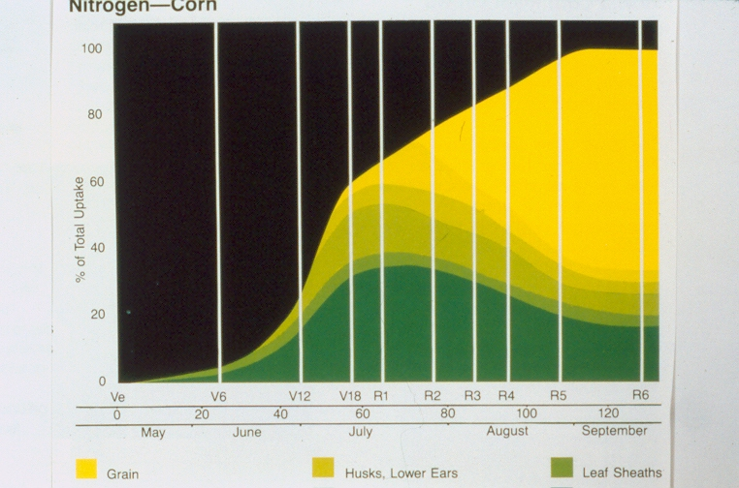
Nitrogen - Corn

Slide 20
Timing N Application
Split application
Portion before planting, maybe with herbicide
Some at planting
Some side-dress
Late season if possible

Slide 21
Rock Phosphate Reactions
Phosphoric Acid
Rock Phosphate + Extra Sulfuric Acid −−−>
CaSO₄ + H₃PO₄
(Gypsum) (Phosphoric Acid)
Called green acid because of impurities in the acid
Electric Furnace Phosphorus Acid
Burn rock phosphate
Collect phosphate gas in water to form “food grade phosphoric acid”

Slide 22
Monoammonium Phosphate MAP 11-52-0 (Dry granules)
NH₃ + H₃PO₄ −−−> NH₄H₂PO₄
Nitrogen (N) - 12%
Hydrogen (H) - 5%
Oxygen (O) - 56 %
Phosphorus (P) - 27%
27% P * 2.29 = 62% P₂O₅
There are impurities in the green phosphoric acid that lowers N to 11 % and P₂O₅ to 52% for MAP.

Slide 23
Ammonium Polyphosphates 10-34-0 (Fluid fertilizer)
NH3 + Super phosphoric Acid = several phosphate compounds, for example
(NH₄)₃HP₂O₇ (NH₄)₃H₂P₃O₁₀ NH₄H₂PO₄
65-70% Polyphosphate and 30-35% Orthophosphate

Slide 24
Phosphate Forms
Orthophosphate = PO₄
Polyphosphate is made by heating
2H₃PO₄ + Heat ---> H₄P₂O₇ + H₂O
When applied to the soil, oxygen from water breaks the poly bond by hydrolysis
Hydrolysis
H₄P₂O₇ + H₂O ---> 2H₃PO₄

Slide 25
Phosphorus
Phosphorus is attached to soil particles and does not move very far in the soil from year to year.
Yes, phosphorus does move in the soil. About 0.75 of an inch per year for silt loam soils and about 2 inches in sandy soils.
Phosphorus is not fixed but remains available for future use by plants.

Slide 27
Soil Phosphorus Mehlich 3 or Bray P1
For 150 bu/A corn : 25 ppm P
For 250 bu/A corn: 40 ppm P
Above 50 ppm P
No phosphate fertilizer is needed

Slide 28
Phosphorus Recommendations
Bray P-1 / Mehlich P-3
Soil test ppm P Rating lbs P2O5/A
0-5 Very Low 60-140
6-12 Low 35-75
13-25 Medium 20-45
26-50 High 0-30
51+ Very High None

Slide 29
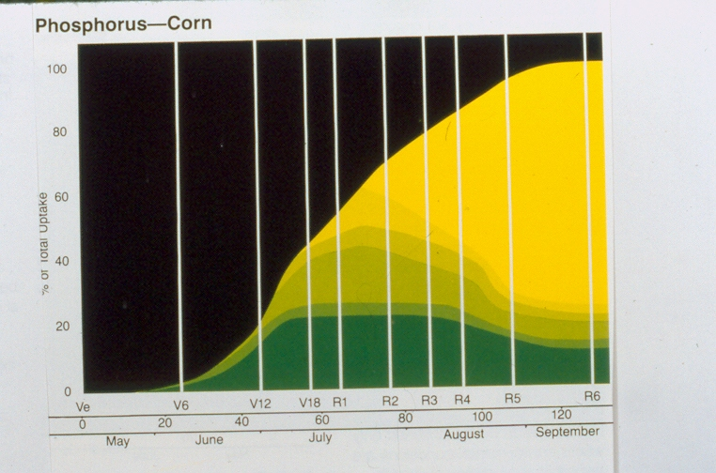
Phosphorus Corn

Slide 30
Potassium Chloride KCL (Dry granules)
Potassium (K) - 52%
Chloride (Cl) - 48%
52% K * 1.2 = 62% K₂O
Red crystals have iron impurities resulting in 0 - 0 - 60 - 45Cl

Slide 32
Exchangeable Soil Potassium
150 bu/A corn: 160 ppm K
250 bu/A corn: 200 ppm K
How much higher should K go for 300+ bu/A?

Slide 33
Potassium Recommendations
Soil Test ppm K Rating lbs K2O/A
0-40 Very Low 90-200
41-80 Low 50-120
81-120 Medium 25-60
121 - 200 High 0-35
201+ Very High None

Slide 34
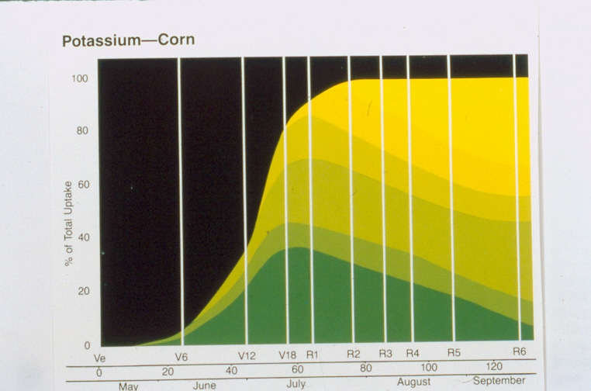
Potassium Corn

Slide 35
Sulfur Soil Test, Ca-P Extractable
Soil Test ppm S Rating for high yields
0-4 Very Low
5-9 Low
10-15 Medium
16-21 High
22+ Very High

Slide 36
Sulfur Requirement
Crop Yield Unit LBS of S
Corn Bushel 0.22
Soybean Bushel 0.25
Wheat Bushel 0.32
Alfalfa Ton 5.0
Grass Ton 3.0

Slide 37
Sulfur Recommendation Example
Corn at 240 bu/A Yield Goal
Sulfur Requirement is 0.22 lb S/bu
Total S Required is 53 lbs/A
Sulfate Soil Test is 14 ppm S
14 ppm X 0.3 X 8 inches = 34 lbs S/A
S fertilizer = 19 lbs of S/A
Recommendation is 28 lbs S/A

Slide 38
Calcium, Magnesium, and Sodium
Part of the base saturation. % K, %Ca, %Mg, and % Na should add up to 70 % or greater
Hydrogen. H should be less than 30 %.
If sodium (Na) percentage is greater than 5% there is a problem.

Slide 39
Calcium:Magnesium Ratio
In summary, the Ca:Mg ratio concept is unproven and should not be used as a basis for fertilization or liming practices.
Having sufficient levels of Ca and Mg is the proper method of evaluation.
rather than trying to manipulate ratios.

Slide 40
Response to Micronutrients
Corn Grain Sorghum Wheat
Zinc High Medium Low
Iron Medium High Low
Manganese Low High High
Copper Medium Medium High
Boron Low Low Low
Chloride High High High

Slide 41
Zinc, DTPA Extraction
Trace element that is needed on the most acres of corn.
The zinc test needs to be greater than 1 ppm Zn.

Slide 42
Zinc Recommendations
DPTA, ppm Zn lb Zn/A
0-0.25 3-12
0.26-0.50 1-7
0.51-.75 0-6
0.76-1.00 0-3
1.01+ None
Divide Rate by 6 for amount per year.

Slide 43
Zinc Sources
Zinc Sulfate ZnSO4 – 7 H2O
33 to 36 % Zn
Zinc Chelates
Many names
EDTA chelate most stable and most expensive

Slide 44
Manganese, DTPA Extraction
Manganese seems to getting lower in our soils.
Manganese may be needed when soil test is below 3.0 ppm Mn
Possible soil treatment of 5 lbs of Mn/A of 28 % Mn as MnSO4-3H2O
Mn Chelate at 0.15 lb Mn/A

Slide 45
Manganese Soil Test (DTPA) and Recommendations
Mn Rate
DTPA, ppm Mn Rating Lbs Mn/A
0-0.5 V Low 10
0.6-1.5 Low 5-9
1.6 – 3.0 Medium 1-4
3.1+ High 0

Slide 46
Copper Soil Test (DTPA) and Recommendations
DTPA, ppm Cu Rating Lbs of Cu/A
0-0.10 Low 3-6
0.11-0.20 Medium 1-2
0.21-0.30 High 0
0.31-0.60+ V High* 0
* Specialty crops get Copper up to 0.60 ppm
Use Copper sulfate (CuSO4 – 5H2O)

Slide 47
Soil Boron
For Corn and most crops Hot Water Soluble Boron soil test should be above 0.25 ppm B
For alfalfa, sugar beets and peanuts boron should be above 0.50 ppm B

Slide 48
Boron Soil Test and Recommendations
B Soil Test, ppm Rating Lbs B/A
0 – 0.25 Low 0.5 – 3.0
0.26 – 0.50 Medium 0.0 – 1.7
0.51 + High 0
Alfalfa, clover, peanuts, cotton and sugar beets require more boron than other crops.
Solubor is 20 % B.

Slide 49
Soil Chloride, 24 inch Sample
Rating (KSU) ppm Cl lbs Cl/A
Low 0-3 20
Medium 4-6 10
High 6+ 0
Dry potassium chloride (0-0-60+45Cl)
Dry ammonium chloride (25-0-0+64Cl)
Liquid ammonium chloride (6-0-0-16.5Cl)

Slide 50
Factors Affecting Active Nutrient Uptake
Oxygen
Temperature
Ion Interference

