Slide 1
Soil Clay Minerals and CEC
Ray Ward
Ward Laboratories, Inc
Kearney

Slide 2
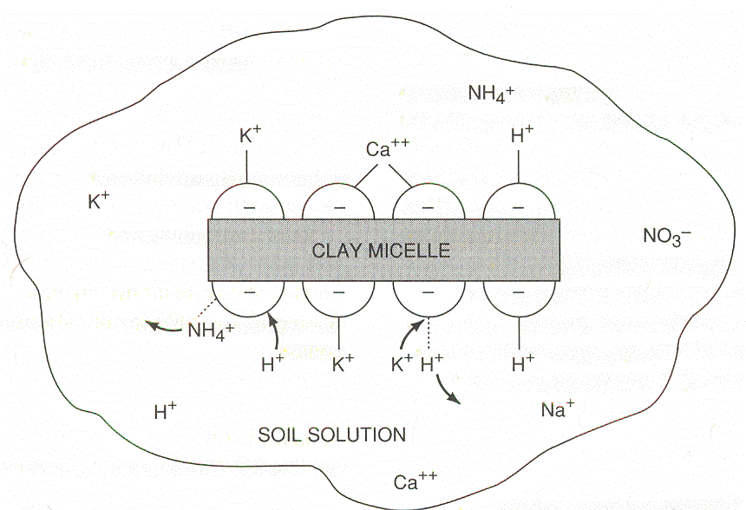
CATION ADSORPTION

Slide 3
“Activity” of silicate clays
refers to cation exchange capacity (CEC)
Ability to retain and supply nutrients
Fertility
High activity clays:
Less weathered ; high effective surface area
smectite, vermiculite, mica (illite), chlorite
Low activity clays:
More weathered; less effective surface area
kaolinite

Slide 4
Silicate Clays (aluminosilicates)
Particle of silicate clay
Composed of tetrahedral and octahedral “sandwiches”
Tetrahedron: central cation (Si⁺⁴, Al⁺³) surrounded by 4 oxygens
Octahedron: central cation (Al⁺³,Fe⁺², Mg⁺²) surrounded by 6 oxygens (or hydroxyls)

Slide 5
Tetrahedron -
Constituents
Oxygen - OH⁻ or O²⁻ - surrounds cations and determines structure Silicon - Si⁴⁺ Aluminum - Al³⁺ 4 Base Cations - Na⁺, Ca²⁺, K⁺, Mg²⁺

Slide 6
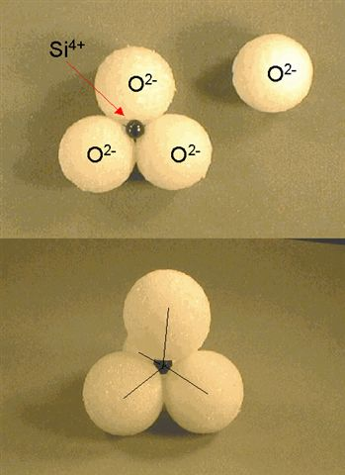
Tetrahedron
4 O's in a 4-sided pyramid around a central cation
The Hole in the middle of a tetrahedron is small: only Si⁴⁺ and Al³⁺ can fit in it

Slide 7
1.Silicate Clays

Slide 8
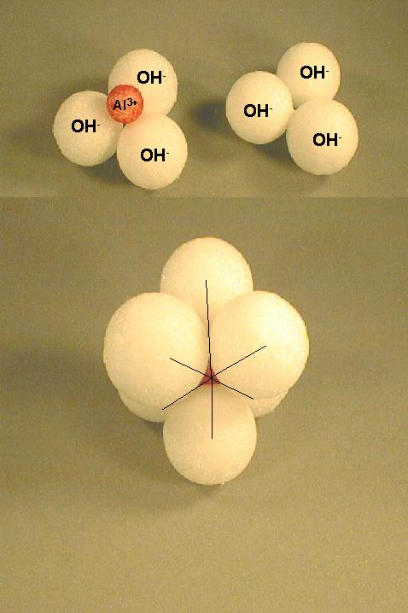
Octahedron 6 OH's in an 8-sided arrangement around a central cation
Octahedrons have a larger hole in the middle Al³⁺, Fe²⁺ and Mg²⁺ can fit in octahedral

Slide 9
1.Silicate Clays

Slide 10
Silicate Clays
Different types of silicate clays are composed of sandwiches (combinations) of layers with various substances in their interlayer space.
2:1 two tetrahedral sheets to one octahedral sheet
1:1 one tetrahedron sheet to one octahedral sheet

Slide 11
Montmorillinite aka Smectite
2:1 structure - 2 silica tetrahedra sandwiching 1 Al octahedra
Little substitution in tetrahedral sheet
Mg²⁺ substitutes for Al³⁺ in octahedral sheet - negative charge only clay with substitution in octahedral sheet
Forms from solution high in Mg²⁺ and silica (semi-arid)
Cations adsorbed in interlayer with water:
Expanding clays of Vertisols
High negative charge (high CEC - 80 cmol+/Kg)

Slide 12
Montmorillinite OR Smectite
2:1
Weathering product
Always negative due to isomorphous substitution
Layers weakly held together by weak O-O bonds or cation-O bonds
Cations adsorbed in interlayer space
Expandable
High CEC

Slide 13
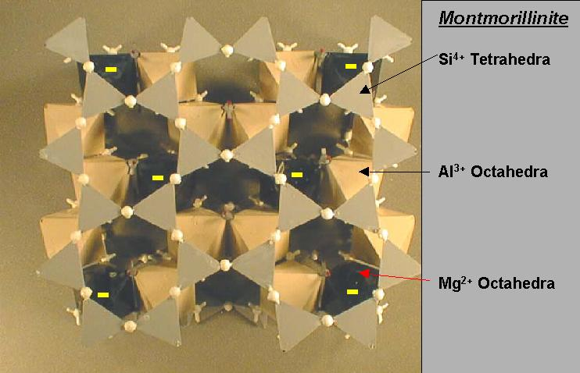
Top View

Slide 14
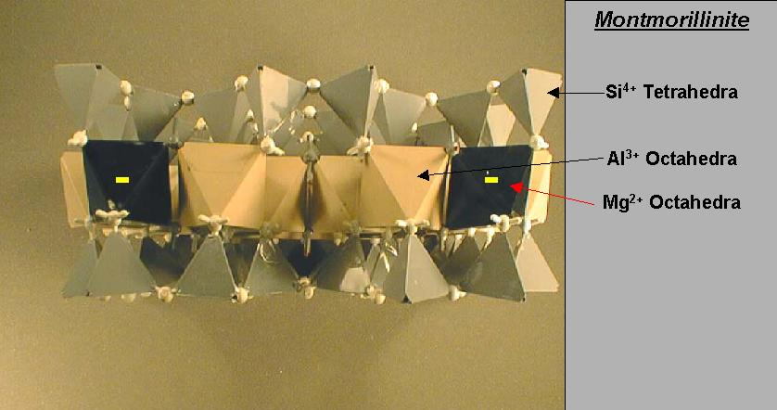
Side View

Slide 15
Top View

Slide 16
smectite
Interlayer cations hold layers together
In dry soils, bonding force is strong and hard clods form; deep cracks
In wet soils, water is drawn into interlayer space and clay swells.
Montmorillonite
Vertisols
Dominant clay mineral of most NE soils

Slide 17
smectite
High effective surface area = 650 – 800 m²/g
Internal surface area >> external
Particles small
Most expandable of all clays

Slide 18
Illite
2:1 Structure with K⁺ Derived from mica - aka hydrous mica Sufficient K⁺ to hold plates together Formed by alteration of mica - edges
by K+ addition to Mont. or Verm. (heat & pressure)

Slide 19
Top View

Slide 20
Side View

Slide 21
Kaolinite
1:1
Hydrogen bonds in interlayer space
strong
Nonexpandable
Low CEC
Particles can grow very large (0.2 – 2 µm)
Effective surface area = 10 – 30 m²/g
External surface only

Slide 22
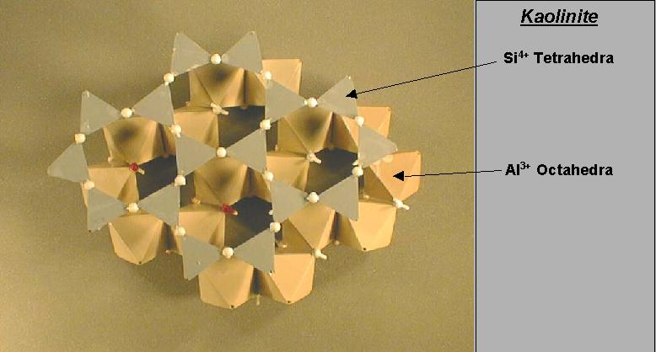
Top View

Slide 23
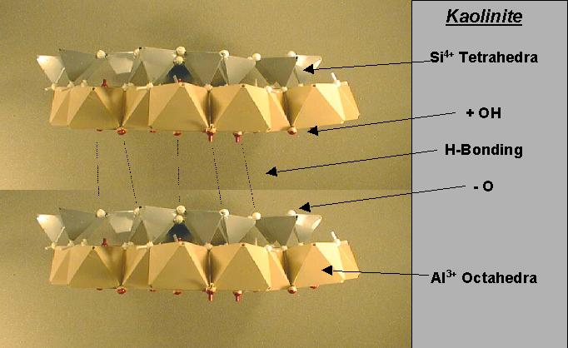
Side View

Slide 24
Weathering
Primary Minerals
Air
Water
Secondary Clay
Minerals
Organic
Material
Soluble
Salts

Slide 25
Soluble Salts
Sodium
Potassium
Calcium
Magnesium and a little iron
Carbonate and bicarbonate
Chloride
Sulfate
Nitrate

Slide 26
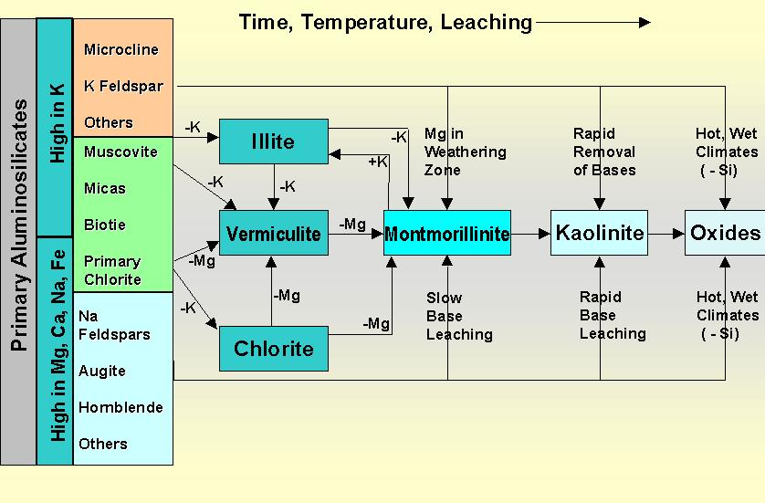
Clay sequences occur through time as conditions change These sequences may be altered by climate and parent material

Slide 27
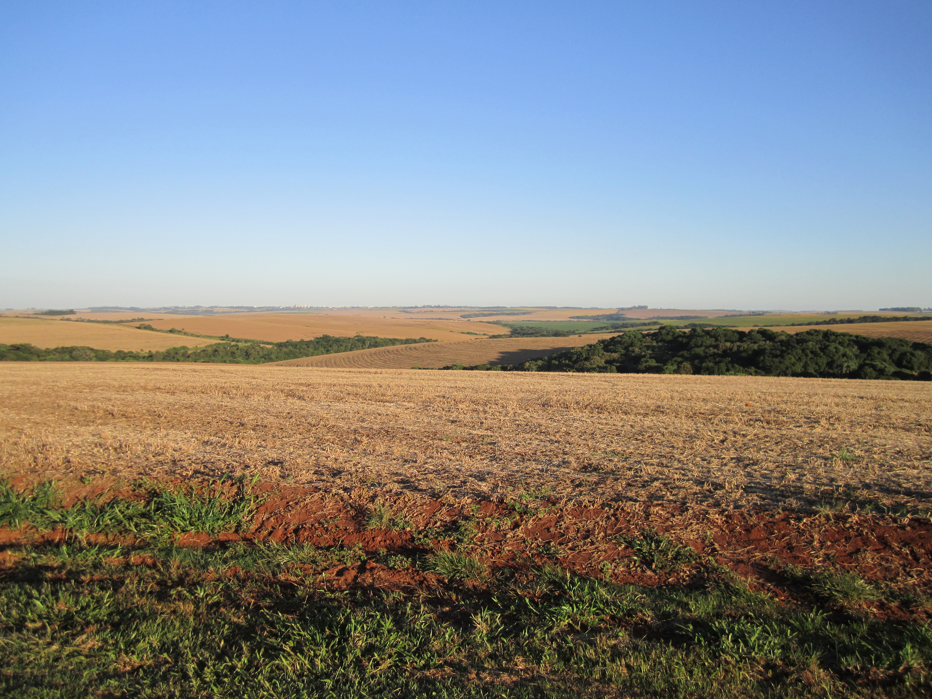
Weathering Transformation of minerals in an environment in which they are unstable to products of greater stability
Mineral stability depends on solution composition, which is affected by the minerals dissolving Solution composition changes as new minerals form and leaching occurs
Weathering leads to structurally simpler compounds
Climatic Effects
Dry | More Base Cations/Si | Primary Silicate Minerals
Wet, Cold, Young | Base Cations lost, 2º clays | 2:1 Layer Silicate clays
Wet, Warm, Old | Base Cations lost, Si leaching | 1:1 Layer Silicate clays
Hot, Wet, Old | Silica lost | Oxide Clays

Slide 28
Generalized relationships:
Ultisols | Kaolinite, oxidic clays
Oxisols
Alfisols | Mica, vermiculite, smectite
Mollisols
Vertisols
Andisols | Amorphous

Slide 29
Cation Exchange Capacity, meq/100g (cmol+/Kg)
Average Range, meq/100g
Humus 200 100-300
Vermiculite 150 100-200
Smectite 100 60-120
Illite 30 20-40
Kaolinite 8 3-15

Slide 30
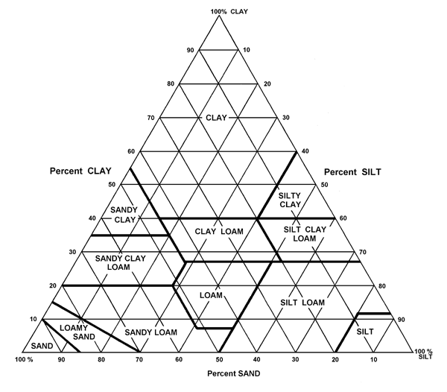
Sand + Silt + Clay = 100%
40 % Sand
40 % Silt
Texture = LOAM
20 % Clay

Slide 31
CEC of a Loam Soil Texture
3 % OM
20 % Clay
CEC = 3/100 * 100 + 20/100 * 60
CEC = 3 + 12
CEC = 15 meq/100 g

Slide 32
Calcium, Magnesium, and Sodium
Part of the base saturation. % K, %Ca, %Mg, and % Na should add up to 70 % or greater
Hydrogen. H should be less than 30 %.
If sodium (Na) percentage is greater than 5% there is a problem.

Slide 33
Sodium
% Na – 5 % * CEC * 1.7 = tons of gypsum needed to move sodium out of the top soil.

Slide 34
Calcium:Magnesium Ratio
In summary, the Ca:Mg ratio concept is unproven and should not be used as a basis for fertilization or liming practices.
Having sufficient levels of Ca and Mg is the proper method of evaluation.
rather than trying to manipulate ratios.

Slide 35
Estimating CEC or Sum of Cations
We use ammonium acetate
Ammonium ions (cation) in the extracting solution exchange with the other cations because of the very high concentration of ammonium ions
This is a very good estimate of CEC for soils that have a soil pH 7.0 and below.
Above soil pH of 7.0 the CEC will be greater than the real CEC

Slide 36
Estimating CEC or Sum of Cations
Calcium = ppm Ca/200
Magnesium = ppm Mg/120
Potassium = ppm K/390
Sodium = ppm Na/230
Hydrogen = (7.0 – buffer pH) * 10
Add all together for CEC

Slide 37
Estimating Texture from CEC
CEC ranges for different soil textures, pH<7.0 (meq/100g)
Sand <6
Sandy Loam 5-10
Loam 9-18
Clay Loam 15-25
Clay >22

